Slide 1
Real-Time Navigation of Mecanum Wheel based Mobile Robot
Mobile Robotics – assignment 1
Tashfeen ali ahmed

Slide 2
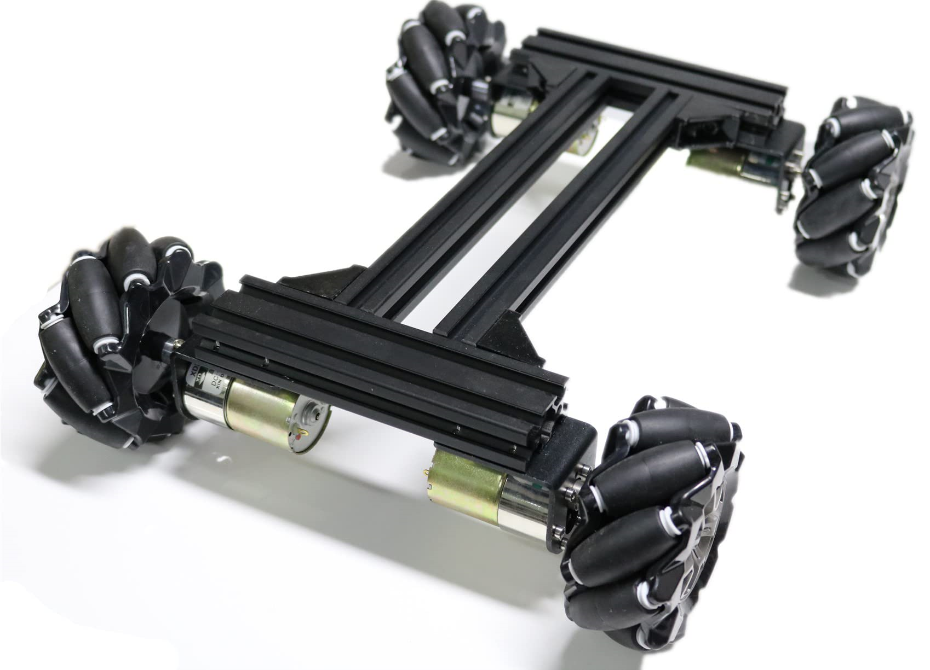
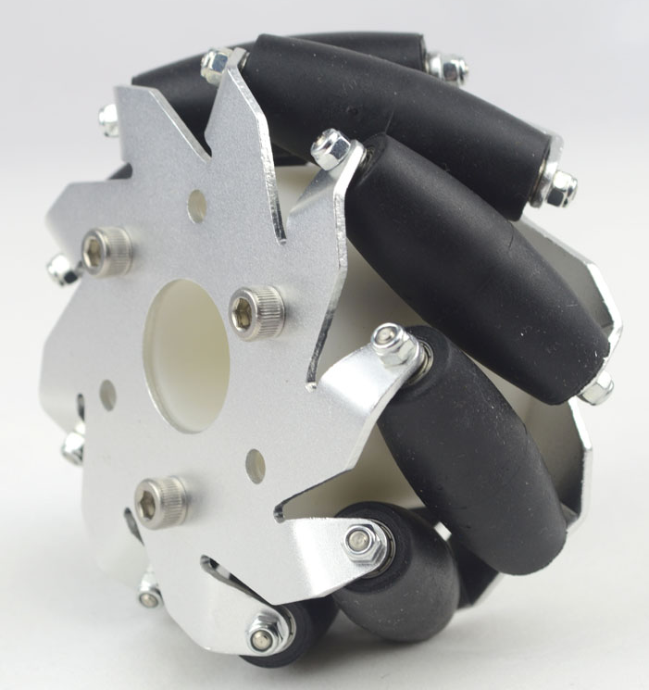
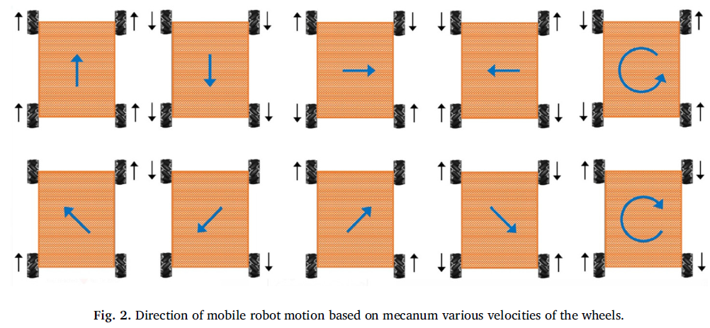
Omni-directional Wheel

Slide 3
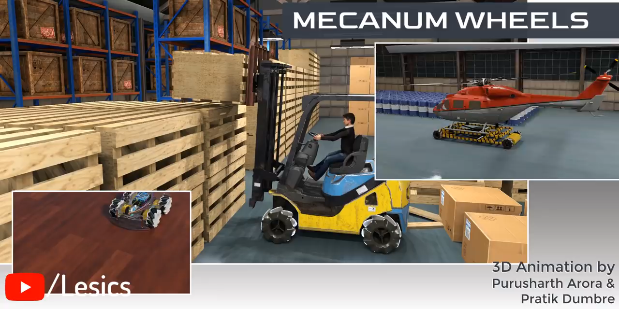
Omni-directional Wheel

Slide 4
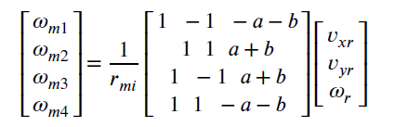
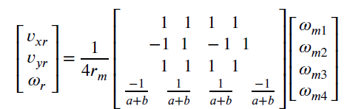
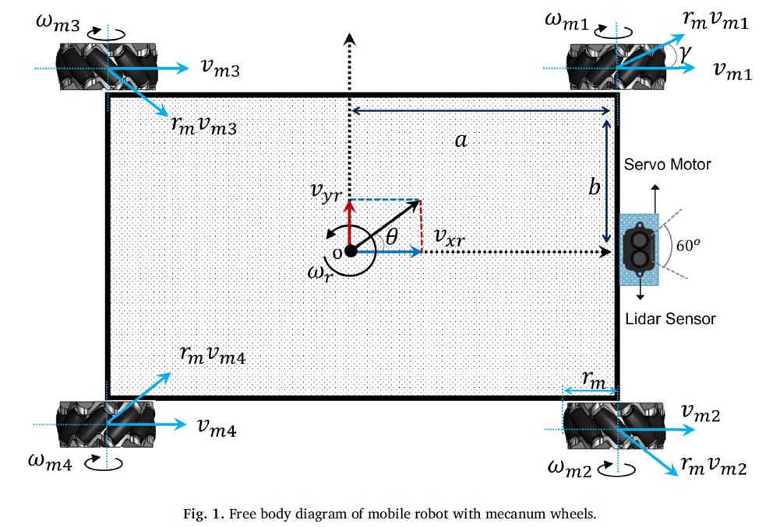
kinematics
Inverse Kinematics:
Forward Kinematics:

Slide 5
Thank you

